Slide 1

GENERATIVE MODEL FOR ANTICANCER PEPTIDE.
RESEARCH TASK - 3
Research Tracking – Sadik Bhattarai
NSCL LAB

Slide 2
Paper title
Paper Link
Take Home Message
Interesting Figures
Other notes

Slide 3
Paper title : Bioactive peptides for anticancer therapies (Review)
Paper Link https://www.ncbi.nlm.nih.gov/pmc/articles/PMC10189813/
Take Home Message:
Anticancer peptides (ACPs) are gaining attention as novel therapeutic and diagnostic candidates for cancer treatment due to their advantages over conventional methods.
ACPs exhibit high efficacy in inducing cancer cell death and have been developed as drugs and vaccines, undergoing evaluation in clinical trials.
ACPs offer increased specificity and toxicity towards malignant cells while reducing side effects on normal cells, making them promising for targeted cancer therapies.
most classical anticancer drugs lack the property to distinguish cancer cells from normal ones, thus resulting in systemic toxicity and adverse side effects (e.g., anaemia, gastrointestinal mucositis, alopecia, or cardiotoxicity).
Interesting Figures
Other notes

Slide 4
Paper title : Accelerating the Discovery of Anticancer Peptides through Deep Forest Architecture with Deep Graphical Representation
Paper Link https://www.ncbi.nlm.nih.gov/pmc/articles/PMC10189813/
Take Home Message:
Interesting Figures
Other notes

Slide 5
Paper title :GCNCPR-ACPs: a novel graph convolution network method for ACPs prediction
Paper Link https://www.ncbi.nlm.nih.gov/pmc/articles/PMC10189813/
Take Home Message:
Collapse Pooling and Residual Network to predict the ACPs which automatically and accurately predicts ACPs using residual graph convolution networks, differentiable graph pooling, and features extracted using peptide sequence information extraction
GCNCPR-ACPs uses node2vec and one-hot embedding methods to extract initial amino acid features for ACP prediction.
Interesting Figures
Other notes

Slide 6
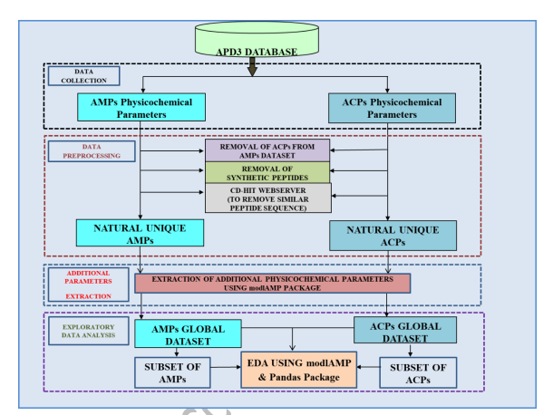
EDA AND STATISTICAL ANALYSIS FOR THE DATA

Slide 7
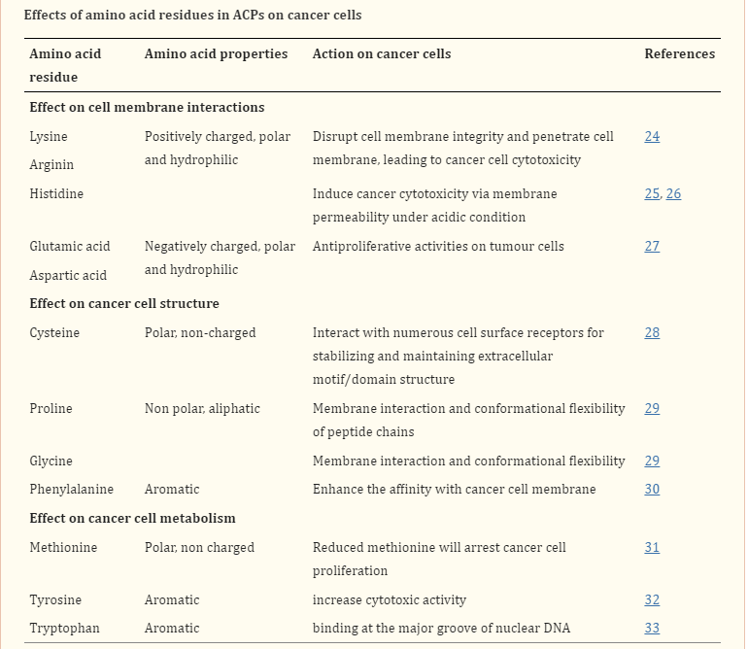
Effects of Each Residues in ACP on cancer cells
https://www.ncbi.nlm.nih.gov/pmc/articles/PMC10189813/

Slide 8
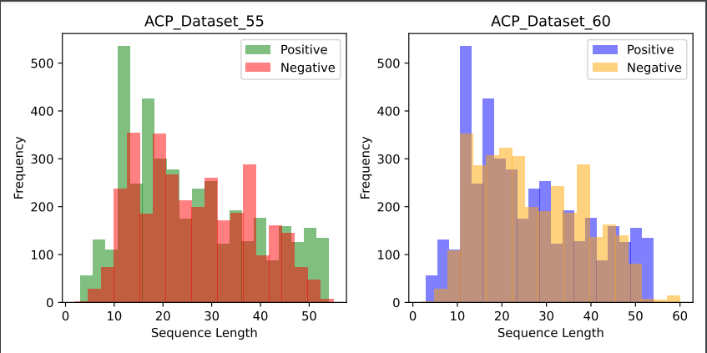
Dataset Creation
This unique dataset are created combiniing the datasets from multiple sources and reviewed method.
Dataset Creations : created a new dataset called as composite training dataset for training of GAN
Fig 1 : Anticancer peptide dataset creation and details

Slide 9
MODELS FOR GENERATION
Transfer Learning with Fine Tuning approach
DIFFUSION MODELS
GAN MODEL **
Autoregressive Models, LSTM, BILSTM, AUTOENCODER MODEL, Transformer Based Generative Models)

Slide 10
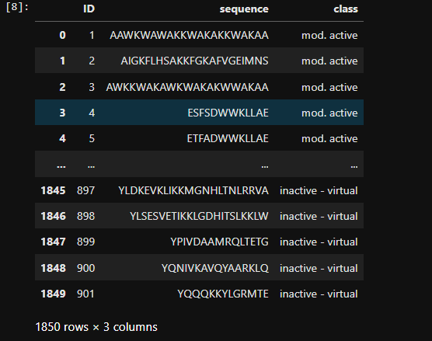
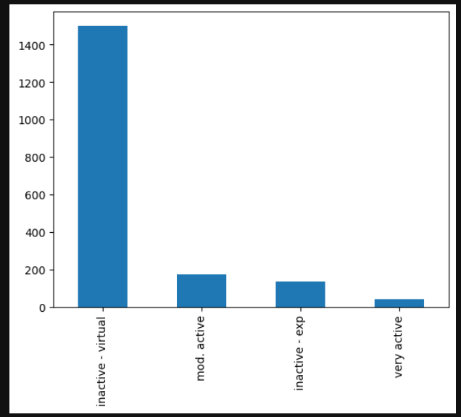
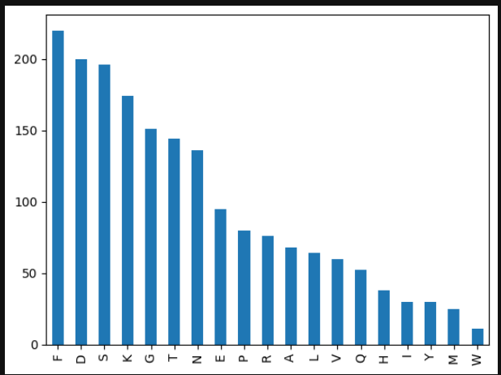
Experimental Work
We retreived a anticancer peptide dataset from Kaggle.

Slide 11
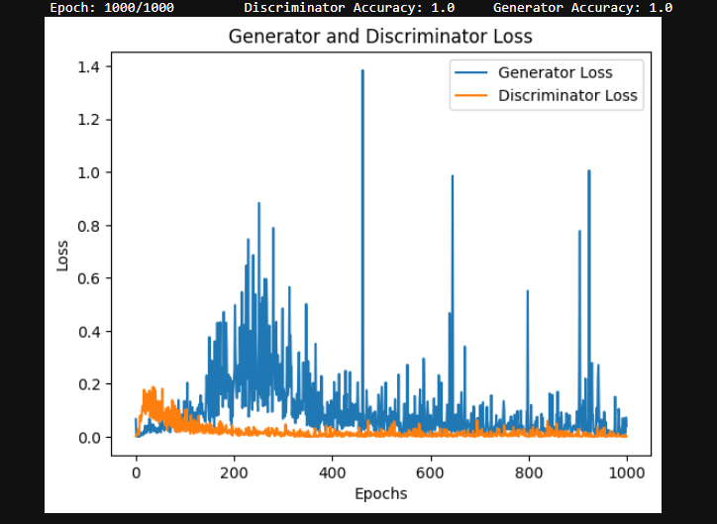
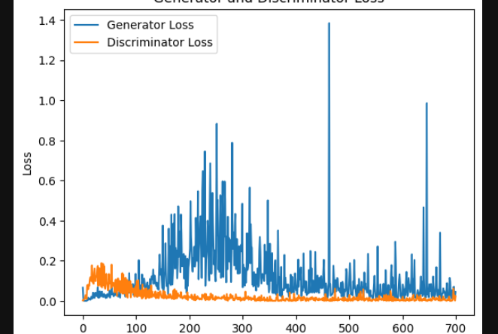
Training result
Fig : Training of the Dense layer GAN network.
This training curve signify that the model suffers a convergence failure where discriminator loss becomes close to zero and generator also decrease to zero.

Slide 12
2023-07-14

Slide 13





Composition difference between healthy cell and Cancer cells
The membrane of malignant normally carries a net negative charge because of the presence of a higher number of anionic components such as the phospholipid phosphatidylserine, O-glycosylated mucins, sialylated gangliosides and heparin sulphate than normal cells, which contributes to the selective cytotoxic property of ACPs.
Cholestrol Biomarkers: Normal cells have large amounts of cholesterol which works as a protective layer to modulate the cell fluidity and block the entrance or passage of cationic ACPs.
In contrast, most malignant cells have increased membrane fluidity, due to the low content of cholesterol in cell membranes, which may make them susceptible to ACPs.
In addition, cancer cells also contain an increased number of microvilli, in contrast to healthy cells.
The presence of microvilli with irregular size and shape on cancer cells can increase the surface area of cells for ACP binding and interactions, influences cell adhesion, and the communications between cancer cells and their environments, and facilities the specific interaction of ACPs with cancer cells.
Certain membrane active peptides disrupt the membrane of mitochondria causing the release of cytochrome c, which induce oligomerization of Apaf-1, activation of caspase-9 and the transformation of pro-caspase-3 to caspase-3, initiating apoptosis in many cancer cells.
For example, the cationic membrane-active peptide (KLAKLAKKLAKLAK) has been shown to target mitochondria and trigger apoptosis after fusing to a CNGRC homing domain

Slide 14
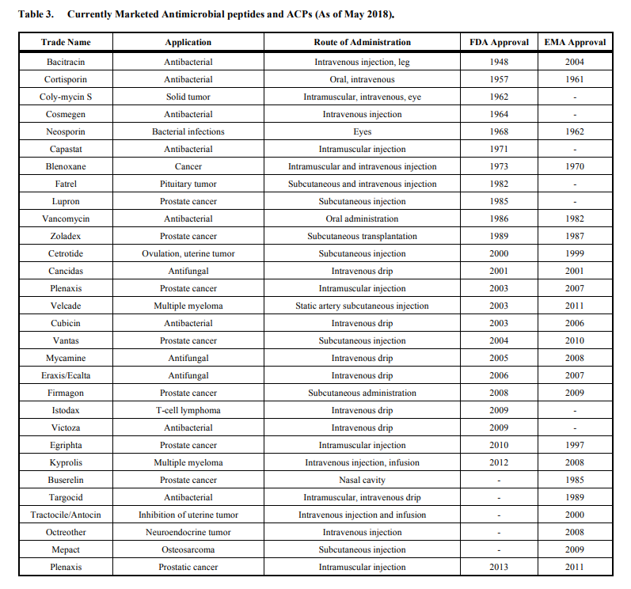
Currently Marketed Antimicrobial peptides and ACPS (As of May 2018)

Slide 15
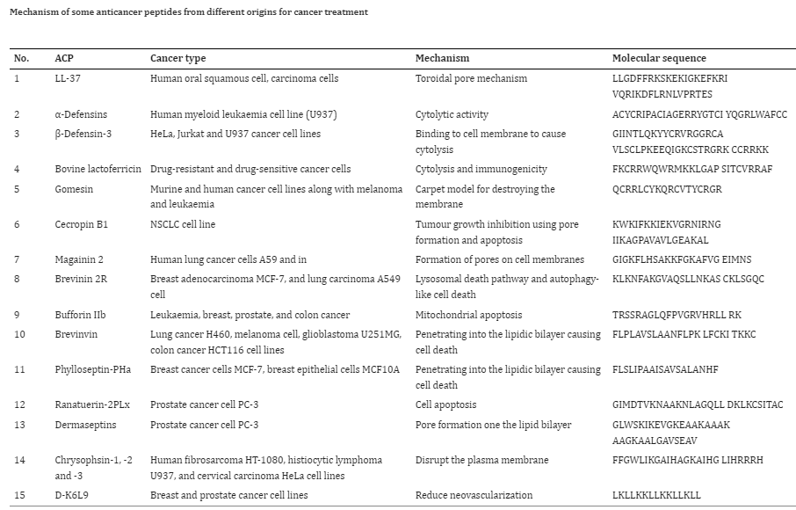
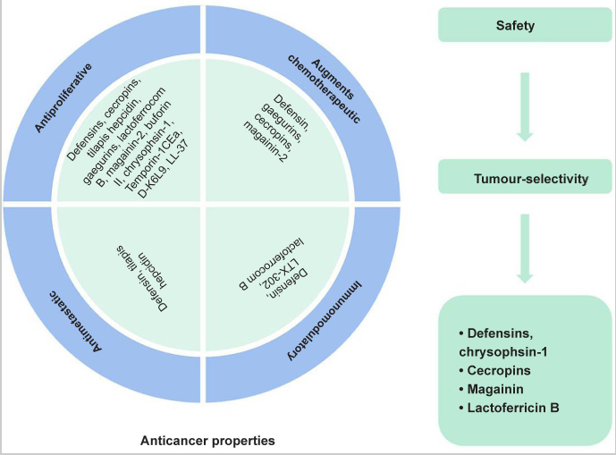
List of bioactive peptides with potentials for anticancer therapies

Slide 16
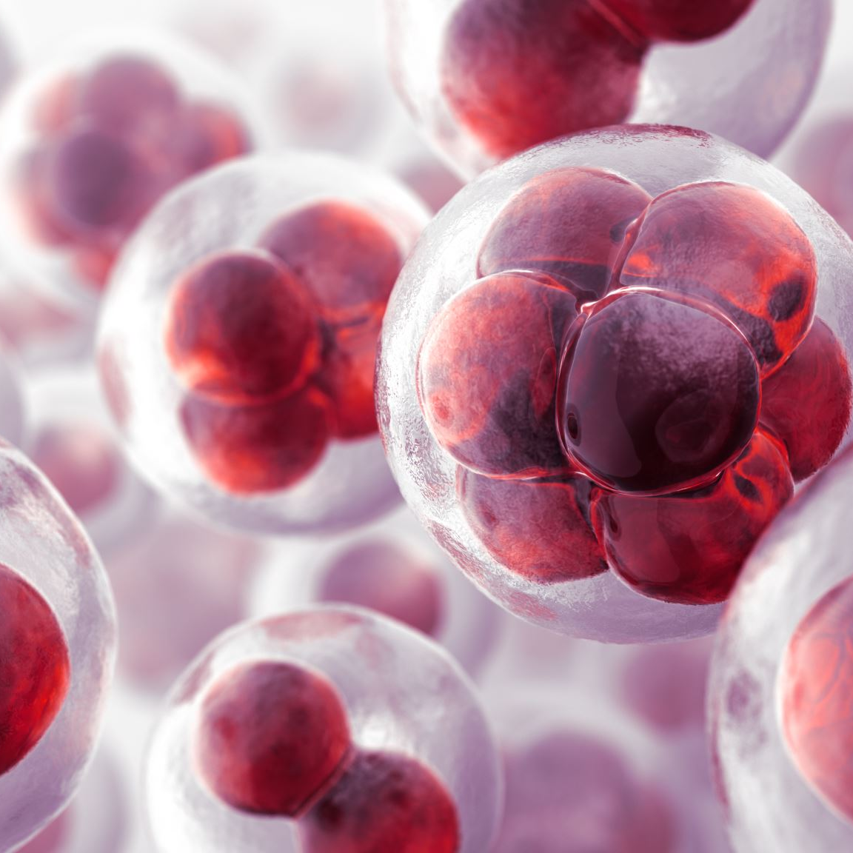
Therapeutic Target for Anticancer peptides
Here is a list of common therapeutic targets in anticancer research:
Epidermal Growth Factor Receptor (EGFR): EGFR is a cell surface receptor involved in the regulation of cell growth and division. EGFR inhibitors are used to target cancers that overexpress EGFR, such as lung, colorectal, and head and neck cancers.
Human Epidermal Growth Factor Receptor 2 (HER2): HER2 is a protein that plays a role in cell growth and survival. HER2-targeted therapies, such as trastuzumab, are effective against breast and gastric cancers that have HER2 amplification or overexpression.
Vascular Endothelial Growth Factor (VEGF): VEGF is a protein that promotes the growth of new blood vessels. Inhibitors of VEGF, such as bevacizumab, are used to target tumor angiogenesis and are used in the treatment of various cancers, including colorectal, lung, and renal cell carcinoma.
Poly(ADP-ribose) Polymerase (PARP): PARP enzymes are involved in DNA repair processes. PARP inhibitors, such as olaparib, are used in the treatment of cancers with defects in DNA repair, particularly those with BRCA mutations, such as ovarian and breast cancers.
BCR-ABL Tyrosine Kinase: BCR-ABL is a fusion protein produced by the Philadelphia chromosome, which is associated with chronic myeloid leukemia (CML) and some cases of acute lymphoblastic leukemia (ALL). Tyrosine kinase inhibitors (TKIs), such as imatinib, target the BCR-ABL protein and have revolutionized the treatment of CML.
Programmed Cell Death 1 (PD-1) and Programmed Death-Ligand 1 (PD-L1): PD-1 and PD-L1 are immune checkpoint proteins that regulate T cell activity. Monoclonal antibodies targeting PD-1 (e.g., pembrolizumab) or PD-L1 (e.g., atezolizumab) have been developed to enhance the immune response against cancer cells and are used in the treatment of various cancers, including melanoma, lung cancer, and bladder cancer.
B-Cell Lymphoma 2 (BCL-2): BCL-2 is a protein involved in regulating programmed cell death (apoptosis). Inhibitors of BCL-2, such as venetoclax, have shown efficacy in the treatment of certain hematological malignancies, including chronic lymphocytic leukemia (CLL) and acute myeloid leukemia (AML).
Anaplastic Lymphoma Kinase (ALK): ALK is a receptor tyrosine kinase that is aberrantly activated in some cancers, such as non-small cell lung cancer (NSCLC) and anaplastic large cell lymphoma (ALCL). ALK inhibitors, such as crizotinib, are used to target tumors with ALK gene fusions.
Mitogen-Activated Protein Kinase (MAPK) Pathway: The MAPK pathway is a signaling pathway involved in cell proliferation and survival. Inhibitors of key proteins in this pathway, such as BRAF inhibitors (e.g., vemurafenib) and MEK inhibitors (e.g., trametinib), are used in the treatment of cancers with mutations in the MAPK pathway, such as melanoma and certain types of colorectal cancer.
Cyclin-Dependent Kinases (CDKs): CDKs are enzymes involved in cell cycle regulation. Inhibitors of CDKs, such as palbociclib and ribociclib, have been developed to target specific cyclin-CDK complexes and are used in the treatment of hormone receptor-positive breast cancers.
It's important to note that this list is not exhaustive, and there are many other therapeutic targets being explored in anticancer research. The selection of a specific therapeutic target depends on the type of cancer, genetic alterations, and other factors unique to each patient's condition.

Slide 17
Therapeutic Target for Anticancer peptides
Considering anticancer as an example, we can obtain de novo peptides for breast cancer, lung cancer, prostate cancer etc., and the targets can be BCL-2, TOP1, CDK4/6etc .

Slide 18
Generation of Anticancer peptide
Prepare a dataset (anticancer peptides(experimentally verified).
Preprocess the training dataset and evalution of datasets *.
Design a Generative Network *.
Check Relevancy or fidelity of Training and generated samples *.
Screening method for generated peptides (Target Specific) - Check for to which cancer cell lines you want to target (for this dataset is available)*.
Rrosetta for modelling the peptides (check for pyrx too)*.
Docking - Pocket Specific Docking and Flexible Docking (rosetta)- Binding affinity*.
MD simulation of the complex and check for the stability, bonding information and many more*.

Slide 19

Wasserteiner Gan

Slide 20

Wasserteiner GAN
variant of Generative Adversarial Networks (GANs)
introduces a different loss function based on the Wasserstein distance instead of the traditional Jensen-Shannon divergence.
WGANs aim to address some of the challenges faced by traditional GANs, such as mode collapse and training instability.

Slide 21
Main Logic Behind WGAN
Define the generator and discriminator networks:
The generator network takes random noise as input and generates synthetic data samples.
The discriminator network takes both real and generated data samples and tries to classify them as real or fake.
2. Define the loss function:
In a traditional GAN, the loss function measures the divergence between the true data distribution and the generated data distribution. However, this can lead to training instability.
In WGAN, the loss function is based on the Wasserstein distance, which provides a more stable and meaningful measure of the difference between two distributions.
The Wasserstein distance measures the minimum cost (or distance) required to transform one distribution into another.
By optimizing the Wasserstein distance, WGANs encourage the generator to generate samples that are more similar to the real data distribution.
3. Calculate the Wasserstein distance:
To calculate the Wasserstein distance, the discriminator network is modified to provide a real-valued output instead of a probability.
The output of the discriminator represents a critic score, which reflects the quality and realism of the generated samples.
The Wasserstein distance is then computed by finding the difference between the average critic score of the real samples and the average critic score of the generated samples.
4. Train the WGAN:
During the training process, the generator and discriminator networks are updated alternately.
The generator aims to minimize the Wasserstein distance by generating samples that receive high critic scores.
The discriminator (or critic) is trained to maximize the Wasserstein distance by correctly differentiating between real and fake samples.

Slide 22

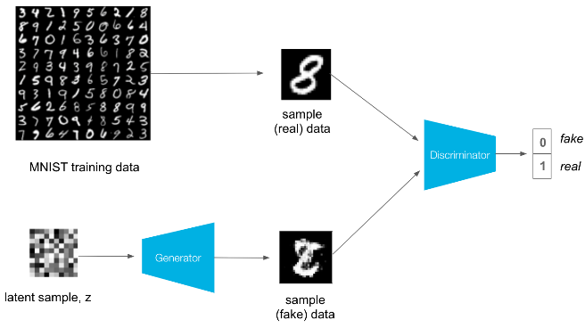
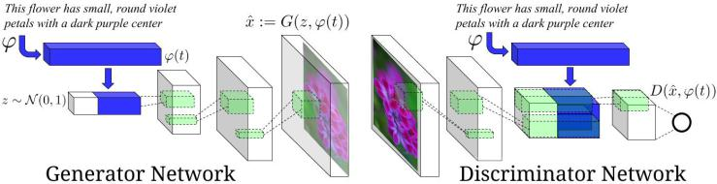
Conditional GAN
This Photo by Unknown author is licensed under CC BY.
A Conditional Generative Adversarial Network (cGAN) is an extension of the traditional Generative Adversarial Network (GAN) that incorporates additional conditioning information to generate targeted or specific outputs.
In a cGAN, both the generator and discriminator receive additional input that provides conditional information, such as class labels, attribute labels, or other types of auxiliary information.
This conditioning enables the generator to generate samples based on specific desired characteristics or properties.
The key difference between a cGAN and a standard GAN lies in the input structure and how the generator and discriminator networks are trained.
In a standard GAN, the generator takes random noise as input and produces synthetic samples, while the discriminator tries to differentiate between real and generated samples.
The objective is to find a Nash equilibrium where the generator can fool the discriminator into classifying generated samples as real.
In a cGAN, the generator and discriminator networks receive both the random noise input and additional conditional input.
This conditioning input provides extra information about the desired properties of the generated samples.
The training process for a cGAN involves updating the generator and discriminator networks simultaneously
The generator aims to generate samples that are not only realistic but also match the specified conditional information.
The discriminator's role remains the same, trying to differentiate between real and generated samples.
Through adversarial training, the generator and discriminator networks compete and improve iteratively.

Slide 23
Work done Monitiring the GAN tutorial https://machinelearningmastery.com/practical-guide-to-gan-failure-modes/
Creation of new datasets combining the training and test dataset(independent dataset) for GAN training
Applied the PC6 Encoding - (Cons) - Exact extraction of peptides with specific properties is difficult
Then, Encoded the peptides uisng the label encoder which maps the peptides into protein dictionary format/similar to tokenization
One hot encdoing to represent the peptide in feature domain
Specific to Anticancer peptides
Design of Wasserteiner GAN

Slide 24
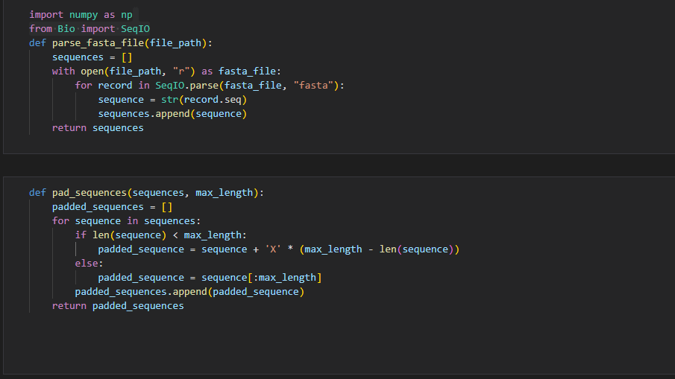
Code

Slide 25
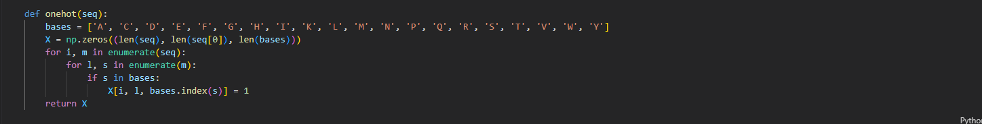
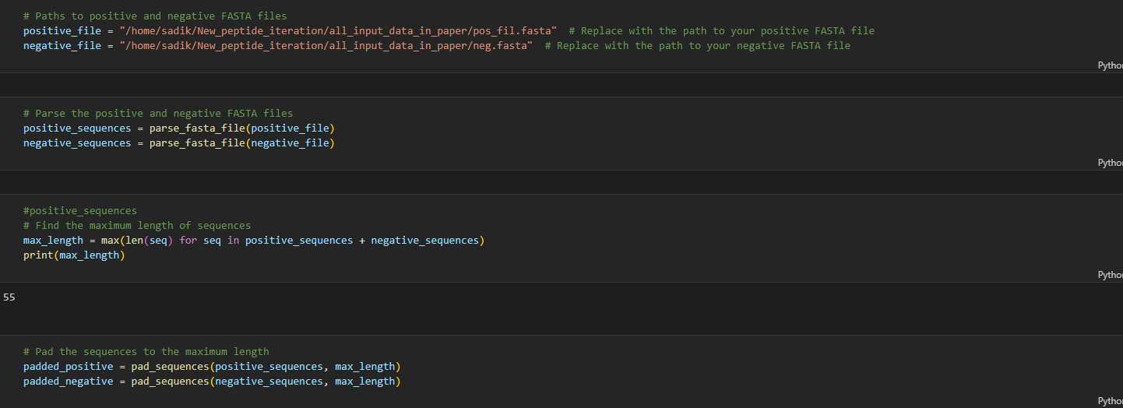
Encoding
Parsing Positive and negative dataset

Slide 26
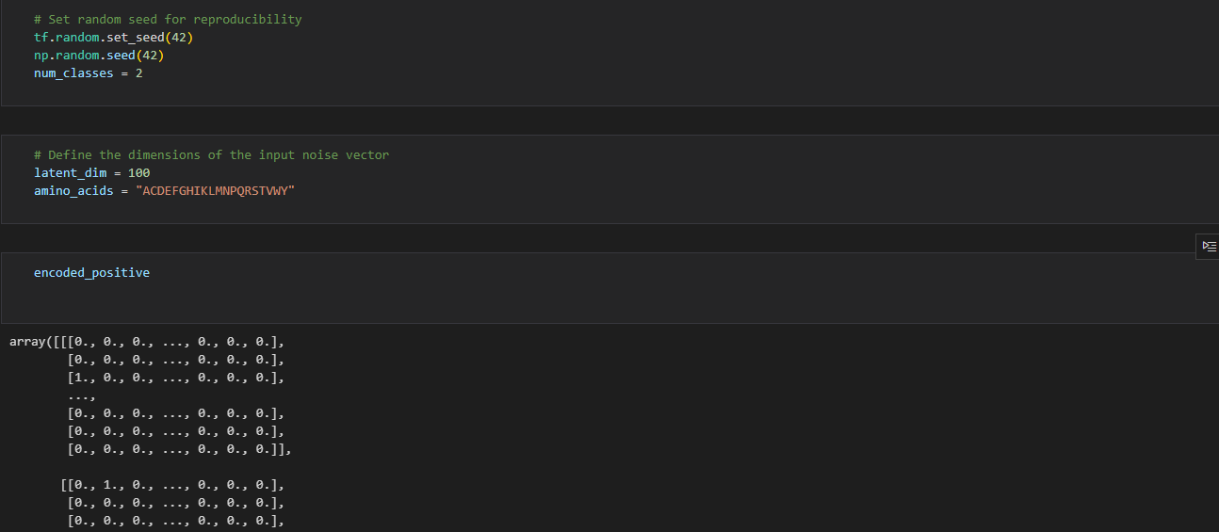
Encoded Positive and Negative using OHE

Slide 27
Network Design for Generation
Under Study about the variation of Generative Model

Slide 28

Paper Submitted
Paper remodified and submitted to Computers in Biology and Medicine
Reason for Rejection
1. The authors claimed their study is a comprehensive review. However, several publications on the same topic are ignored. The authors need to clarify why they ignore these studies, for example, iACP-GAEnsC, AntiCP 2.0, ACPred-Fuse, PEPred-Suite, ACPredStackL, etc.
2. The author should explain in detail the difference between their research and the published review studies of anti-cancer peptide prediction tools. Why is the new review needed?
3. In Tables 4 and 5, where did the performance results come from? Is it extracted directly from the paper? If so, are they guaranteed to be trained and tested on the same data set?
4. In Table 6, are all comparison methods retrained with the same data set? Have they all been optimized? If so, please provide the hyperparameters of each model and the optimization method. In addition, the authors are suggested to include more data to test the performance.
5. Most of the content of this article feels like a list of existing research. It is recommended that the author summarize and analyze the content of the review from multiple angles.
6. The figures are low-quality, especially the timeline.

Slide 29
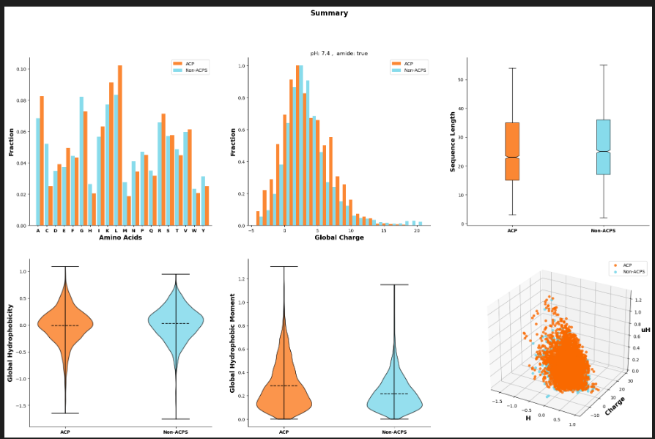
Dataset Analysis using Modlamp Package
This package can be used to calculate the feature descriptors for the peptide sequences.
This package can be used to compare the physicochemical properties of databased relating to different activities (anticancer, antimicrobial and antiviral and many more.
Given figure illustrate the contrast between positive and negative sequences for anticancer peptides and non-acps.

Slide 30
Problem faced while running a code
Module import conflicts, I am managing it and want to run the previous code to understand the core logics of generation of antiviral peptids using LSTM.

Slide 31

Thank you

